Slide 1



Theory Error Bars for Nuclei
Dick Furnstahl
TRIUMF Colloquium, March 2020
Special thanks to my colleagues in BUQEYE, LENPIC, and NUCLEI!

Slide 2
Outline
A brief history of theory error bars for nuclei
Basics of Bayesian statistics for uncertainty quantification (UQ), with examples
Ongoing applications of Bayesian methods to low-energy nuclear theory
Outlook: More frontiers in theory UQ

Slide 3
Outline
A brief history of theory error bars for nuclei
Basics of Bayesian statistics for uncertainty quantification (UQ), with examples
Ongoing applications of Bayesian methods to low-energy nuclear theory
Outlook: More frontiers in theory UQ

Slide 4
Precision era of nuclear physics: 6-8 years ago
Oxygen isotopes with different methods
Ca S_{2n} vs. experiment
²²O spectrum by CCEI
Amazing progress that has not slowed down.
But no error bars then: compare to expt. or use spread of models only.
With limited resources, used them elsewhere!
But how do we know the theory is working as it should? Can extrapolations be trusted? How to choose among theoretical models?

Slide 5
Inspiration from PRA for nuclear theory error bars
Papers presenting the results of theoretical calculations are expected to include uncertainty estimates …
If the authors claim high accuracy, or improvements on the accuracy of previous work.
If the primary motivation for the paper is to make comparisons with present or future high precision experimental measurements.
If the primary motivation is to provide interpolations or extrapolations of known experimental measurements.

Slide 6
History of ISNET movement [https://isnet-series.github.io/]
2012: First one-day workshop [Krakow]
2013: ISNET: Information and Statistics in Nuclear Experiment and Theory [Glasgow]
2014: “Error Estimates of Theoretical Models: a Guide” [Dobaczewski et al]
2015: Information and statistics in nuclear experiment and theory ISNET-3 [Trento]
2015: Journal of Physics G Special Focus Issue: ISNET [J. Phys. G 42, 030301]
2016: Bayesian Methods in Nuclear Physics (ISNET-4) [INT, Seattle]
2017: Information and statistics in nuclear experiment and theory (ISNET-5) [York]
2018: Uncertainty Quantification at the Extremes (ISNET-6) [Darmstadt]
2019: Bayesian Inference in Subatomic Physics (ISNET-7) [Gothenburg]
2020: J. Phys. G Special Focus Issue: ISNET 2.0 is open for submissions!
2020: ISNET-8 in Dec. 2020 at Michigan State University in East Lansing, USA. Organizers: P. Danielewicz, M. Hjorth-Jensen, D. Lee, W. Nazarewicz, S. Pratt, B. Tsang, F. Viens.

Slide 7
Outline
A brief history of theory error bars for nuclei
Basics of Bayesian statistics for uncertainty quantification (UQ), with examples
Ongoing applications of Bayesian methods to low-energy nuclear theory
Outlook: More frontiers in theory UQ

Slide 8
Types of theory error
Uncertainty from numerical method
Truncation of Hilbert space (e.g., lattice volume/spacing or ho model space)
Model discrepancy (“All models are wrong, but some are useful” – George Box)
Incomplete or in parts incorrect physical model
Effective field theory expansion truncation error
Mostly systematic and correlated (doesn’t mean they can’t be treated as random!).
Systematic: error is not reduced when more observations are averaged
Correlated: e.g., model error in binding energy for oxygen chain all in same direction
Bayesian statistics is ideal for modeling, combining, and propagating theory errors!

Slide 9
State of knowledge as probability distributions (pdfs)
pr(A, B | C) “joint probability (density) of A and B given C” (contingent on C)
A, B, C can be observables, parameters, uncertainties, propositions, models, …
cf. quantum mechanics |ψ(x, y)|² or |ψ(x)|² = ∫ |ψ(x, y)|² dy (marginalization)
Bayesian confidence (credible) interval:
68%
95%

Slide 10
State of knowledge as probability distributions (pdfs)
pr(A, B | C) “joint probability (density) of A and B given C” (contingent on C)
A, B, C can be observables, parameters, uncertainties, propositions, models, …
cf. quantum mechanics |ψ(x, y)|² or |ψ(x)|² = ∫ |ψ(x, y)|² dy (marginalization)
Bayesian confidence (credible) interval:
Pr(θ | y_{exp} , Σ_{exp} , Σ_{th} , I) ⇒
pdf of model parameters θ given data y_{exp} and experiment/theory errors Σ, plus other information I
Examples of pdfs for theory UQ:
Notes:
\mathcal{N}e^{-\frac12 \mathbf{r}^{\intercal}{\color{red}\Sigma^{-1}}\mathbf{r}}
&= \mathcal{N} e^{-\frac{(x-\mu)^2}{2\sigma_x^2}} e^{-\frac{(y-\mu)^2}{2\sigma_y^2}}
\\
\mathbf{r} = \begin{bmatrix} x \\ y \end{bmatrix} &
\qquad
{\color{red}\Sigma = \begin{bmatrix} \sigma_x^2 & 0 \\
0 & \sigma_y^2
\end{bmatrix}}
\mathcal{N}e^{-\frac12 \mathbf{r}^{\intercal}{\color{red}\Sigma^{-1}}\mathbf{r}}
&= \mbox{correlated gaussian}
% = \mathcal{N} e^{-\frac{(x-\mu)^2}{2\sigma^2}} e^{-\frac{(y-\mu)^2}{2\sigma^2}}
\\
\mathbf{r} = \begin{bmatrix} x \\ y \end{bmatrix}
\qquad &
{\color{red}\Sigma = \begin{bmatrix} \sigma_x^2 & \rho\sigma_x\sigma_y \\
\rho\sigma_x\sigma_y & \sigma_y^2
\end{bmatrix}}

Slide 11
Projected posterior pdfs as a diagnostic tool
np ³P₀ channel at N3LO in chiral EFT
Projected posteriors give:
information on correlations
“best” parameter values
indication of normality
Often sampled via Monte Carlo
Here: uncorrelated and Gaussian
Natural-sized parameters expected
Wesolowski et al., J. Phys. G (2019)

Slide 12
Projected posterior pdfs as a diagnostic tool
np ¹S₀ channel
at N3LO in chiral EFT
Irregular structure of posterior
Nothing necessarily wrong, but a clue
Here: a physics issue actually explains the distorted structure
Parameter redundancy at N3LO; an operator can be eliminated
True in ³S₁-³D₁ channel as well
Wesolowski et al., J. Phys. G (2019)

Slide 13
Projected posterior pdfs as a diagnostic tool
np 1S0 channel
at N3LO in chiral EFT
Can eliminate redundancy; use only 3 parameters in this channel
Description of data as good and potential is softer!
P. Reinert et al., EPJA (2018) worked out all details and generated much improved EFT potentials
Wesolowski et al., J. Phys. G (2019)

Slide 14
State of knowledge as probability distributions (pdfs)
Posterior pdfs for nuclear DFT parameters
pr(A, B | C) “joint probability (density) of A and B given C” (contingent on C)
A, B, C can be parameters, uncertainties, propositions, models, …
cf. quantum mechanics |ψ(x, y)|² or |ψ(x)|² = ∫ |ψ(x, y)|² dy (marginalization)
Bayesian confidence (credible) integral:
pr(θ | y_{exp} , Σ_{exp} , Σ_{th} , I) ⇒
pdf of model parameters θ given data y_{exp} and experiment/theory errors Σ, plus other information I
Examples of pdfs for theory UQ:
J. McDonnell et al. PRL (2015)

Slide 15
State of knowledge as probability distributions (pdfs)
pr(A, B | C) “joint probability (density) of A and B given C” (contingent on C)
A, B, C can be parameters, uncertainties, propositions, models, …
cf. quantum mechanics |ψ(x, y)|² or |ψ(x)|² = ∫ |ψ(x, y)|² dy (marginalization)
Bayesian confidence (credible) integral:
pr(δy_{th} |y_{th} , I) ⇒
pdf of model discrepancy δy_{th} (model error) given order-by-order theory calculations y_{th} plus other information I
Examples of pdfs for theory UQ:

Slide 16
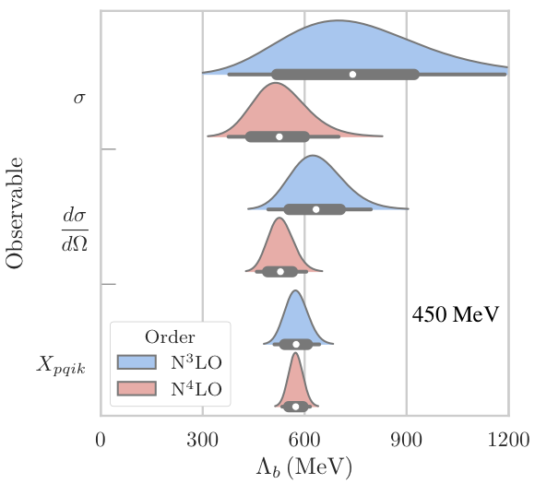
State of knowledge as probability distributions (pdfs)
pr(A, B | C) “joint probability (density) of A and B given C” (contingent on C)
A, B, C can be parameters, uncertainties, propositions, models, …
cf. quantum mechanics |ψ(x, y)|² or |ψ(x)|² = ∫ |ψ(x, y)|² dy (marginalization)
Bayesian confidence (credible) integral:
pr(Λ_{b} | y_{th}, I) ⇒
pdf of breakdown scale of EFT expansion given order-by-order theory calculations y_{th} plus other information I
Examples of pdfs for theory UQ:

Slide 17
State of knowledge as probability distributions (pdfs)
pr(A, B | C) “joint probability (density) of A and B given C” (contingent on C)
A, B, C can be parameters, uncertainties, propositions, models, …
cf. quantum mechanics |ψ(x, y)|² or |ψ(x)|² = ∫ |ψ(x, y)|² dy (marginalization)
Bayesian confidence (credible) integral:
pr(EFT₁ | y_{exp} , I) / pr(EFT₂ | y_{exp} , I) ⇒
ratio of probabilities for two EFT models (EFT₁ and EFT₂) given data y_{exp} plus other information I (“model selection”)
Examples of pdfs for theory UQ:

Slide 18
Bayes’s Theorem: How to update knowledge in PDFs
Likelihood overwhelms prior
Prior suppresses unconstrained likelihood
Notes:
\usepackage{bm}
\DeclareMathOperator{\pr}{\text{pr}} % Good, but want to handle sizing and | spacing?
{\color{red}\pr(A|B,I)} = \frac{{\color{blue}\pr(B|A,I)} {\color[rgb]{0.000000,0.493151,0.000000}\pr(A|I)}}{\pr(B|A)}
\Longrightarrow
{\color{red}\underbrace{\pr(\bm{\theta} | \mathbf{y}_{\rm exp}, I)}_{\mbox{\scriptsize posterior}}}
\propto
{\color{blue}\underbrace{\pr(\mathbf{y}_{\rm exp} | \bm{\theta}, I)}_{\mbox{\scriptsize likelihood}}}
\times
{\color[rgb]{0.000000,0.493151,0.000000}\underbrace{\pr(\bm{\theta} | I)}_{\mbox{\scriptsize prior}}}
{\color{red}\pr(A|B,I)} = \frac{{\color{blue}\pr(B|A,I)} {\color[rgb]{0.000000,0.493151,0.000000}\pr(A|I)}}{\pr(B|A)}
\Longrightarrow
{\color{red}\underbrace{\pr(x | \mbox{data}, I)}_{\mbox{posterior}}}
\propto
{\color{blue}\underbrace{\pr(\mbox{data} | x, I)}_{\mbox{likelihood}}}
\times
{\color[rgb]{0.000000,0.493151,0.000000}\underbrace{\pr(\mbox{data} | I)}_{\mbox{prior}}}
{\color{red}\pr(\bm{\theta} | \mathrm{y}_{\rm exp}, \Sigma_{\rm exp}, \Sigma_{\rm th}, I)}
\propto {\color{blue}e^{-\frac12 \mathbf{r}^{\intercal}(\Sigma_{\rm exp}+\Sigma_{\rm th})^{-1}\mathbf{r}}}
\times {\color[rgb]{0.000000,0.493151,0.000000} e^{-\bm{\theta}^2/2\bar\theta} }
\usepackage{bm}
\newcommand{\pr}{\text{pr}}
&{\color{blue}
%\mbox{likelihood: }
\pr(\mathbf{y}_{\rm exp} | \bm{\theta}, I) \propto e^{-\chi^2/2}
}
\quad\underset{\rm uncorrelated}{\Longrightarrow}\quad
{\color{blue}
\chi^2 = \sum_i^{\rm data} \mathbf{r}_i\frac{1}{\sigma_i^2}\mathbf{r}_i \;,
\quad
\mathbf{r} \equiv \mathbf{y}_{\rm exp} - \mathbf{y}_{\rm th}(\bm{\theta})
} \\[10pt]
&\quad\mbox{correlated: }
{\color{red}\pr(\bm{\theta} | \mathrm{y}_{\rm exp}, \Sigma_{\rm exp}, \Sigma_{\rm th}, I)}
\propto {\color{blue}e^{-\frac12 \mathbf{r}^{\intercal}(\Sigma_{\rm exp}+\Sigma_{\rm th})^{-1}\mathbf{r}}} \times {\color[rgb]{0.000000,0.493151,0.000000} e^{-\bm{\theta}^2/2\bar\theta^2} }
&{\color{blue}
%\mbox{likelihood: }
\pr(\mathbf{y}_{\rm exp} | \bm{\theta}, I) \propto e^{-\chi^2/2}
}
\quad\underset{\rm uncorrelated}{\Longrightarrow}\quad
{\color{blue}
\chi^2 = \sum_i^{\rm data} \mathbf{r}_i\frac{1}{\sigma_i^2}\mathbf{r}_i \;,
\quad
\mathbf{r} \equiv \mathbf{y}_{\rm exp} - \mathbf{y}_{\rm th}(\bm{\theta})
} \\[10pt]
&\quad\mbox{correlated: }
{\color{red}\pr(\bm{\theta} | \mathrm{y}_{\rm exp}, \Sigma_{\rm exp}, \Sigma_{\rm th}, I)}
\propto {\color{blue}e^{-\frac12 \mathbf{r}^{\intercal}(\Sigma_{\rm exp}+\Sigma_{\rm th})^{-1}\mathbf{r}}} \times {\color[rgb]{0.000000,0.493151,0.000000} e^{-\bm{\theta}^2/2\bar\theta^2} }

Slide 19
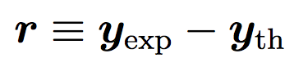
Two ways to treat the theory model discrepancy
Statistical model for observable y:
1. Model the distribution of residuals:
(δy_{exp})_{n} is often a Gaussian with mean μ = 0 and variance σ_{n}²: error bars size σ_{n}
For δy_{th}, look at pattern of residual and model it (e.g., it could also be a Gaussian). Could be treated as uncorrelated or correlated (GP).
2. For effective field theories (EFT), learn from convergence pattern
Expect that each order will roughly improve by expansion parameter Q < 1:
Treat the c_{n}s as random variables and learn their distribution from calculated orders
Theory at order k:
Omitted orders:
Advice from statisticians: any model for theory discrepancy is better than no model!

Slide 20
Convergence pattern example from NN observables
J. Melendez et al. PRC (2017)

Slide 21
LENPIC is now Bayesian!
Analytic Bayesian DOB intervals based on Melendez et al., PRC 96, (2017)
http://www.lenpic.org/
Observables for elastic nucleon-deuteron scattering at 135 MeV.
Filin et al., Extraction of the neutron charge radius from a precision calculation of the deuteron structure radius, arXiv:1911.04877, PRL (2020).
Colored band is 68% Bayes credible interval for truncation error from convergence pattern.
Epelbaum et al, Towards high-order calculations of three-nucleon scattering in chiral effective field theory, arXiv:1907.03608, to be in EPJA (2020).
SMS potentials + consistent 3N
68%/95% bands for Nd obs.
Also: prior sensitivity tests
Error analysis → will need ≥N⁴LO 3N forces for Nd
Notes:
\begin{align*}
y(p) &= y_{\textrm{ref}}(p)(c_0 + c_2 Q^2 + c_3 Q^3 + \cdots) \\
%
Q &= \max\left( \frac{p}{\Lambda_b}, \frac{M_\pi^{\textrm eff}}{\Lambda_b} \right)
\quad \Lambda_b = 600\mbox{--}700\,\mbox{MeV}\\
%
\Longrightarrow&\mbox{\ Analytic posterior for\ }\pr(\delta y_{\rm th}(p) \mid \{c_{i\leq k}\})
\end{align*}

Slide 22
Note: If n_{c} ≫ 1, the posterior for y becomes a normal distribution.
From https://buqeye.github.io/

Slide 23
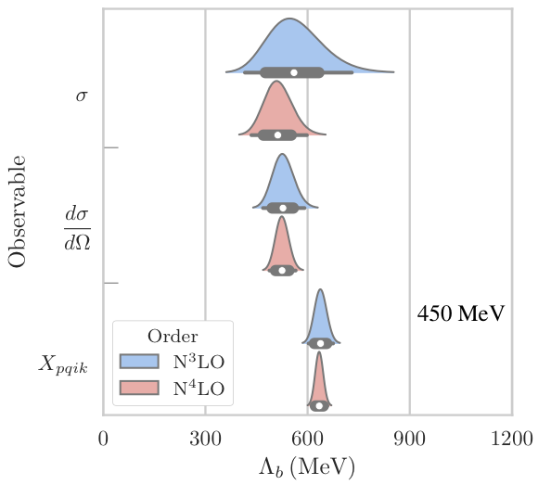
What is the breakdown scale of our effective field theory (EFT)?
Chiral EFT relies on an expansion parameter Q ~ {p, m_{π}} / Λ_{b}
But what is the breakdown scale Λ_{b} (where the terms are all the same)?
We promote Λ_{b} to a random variable with a posterior pdf (Bayesian!)
This posterior is predicted as a byproduct of the δy_{th} estimation.
Posteriors from NN observables at separated energies/angles (independent)
Posteriors from NN observables at many more energies/angles; correlations?
Melendez et al., PRC 96, 024003 (2017) and in preparation (2020)

Slide 24
Correlations with nearby points: Gaussian processes (GPs)
Recall the correlated Gaussian with two points x and y, where 0 ≤ ρ ≤ 1 gives correlation. Now imagine many points x₁, x₂, … x_{N} all of which have a ρ_{ij} correlation given by a function.
Interpolation
Regression
J. Melendez et al., PRC (2019)

Slide 25
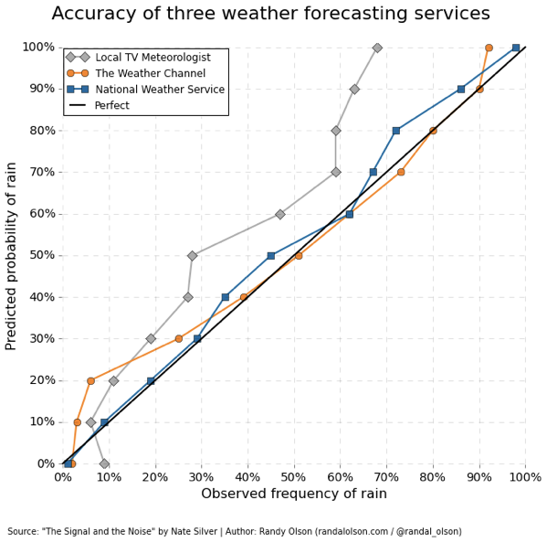
Model Checking: Weather plots
Order-by-order failure
Validates statistical model and EFT breakdown scale
Order-by-order success
Melendez et al., PRC 96, 024003 (2017)
Notes:
Melendez, Furnstahl, Wesolowski, PRC, 2017 after Furnstahl, Klco, DP, Wesolowski, PRC, 2015 after Bagnaschi, Cacciari, Guffanti, Jenniches, 2015

Slide 26
Outline
A brief history of theory error bars for nuclei
Basics of Bayesian statistics for uncertainty quantification (UQ), with examples
Ongoing applications of Bayesian methods to low-energy nuclear theory
Outlook: More frontiers in theory UQ

Slide 27
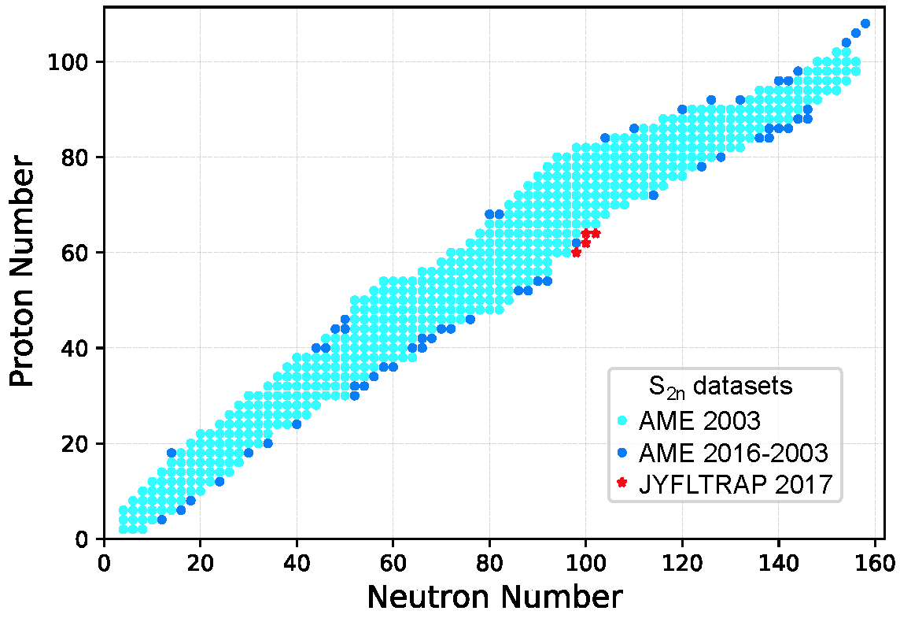
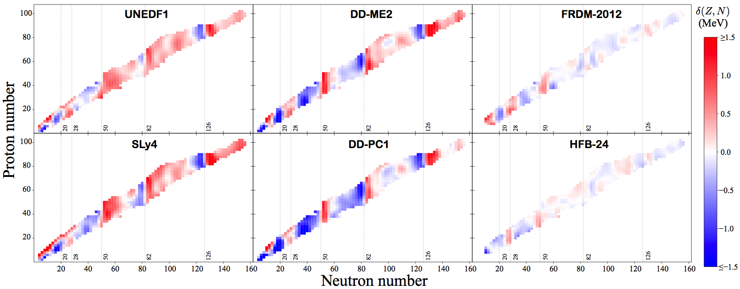
Limits of the nuclear landscape: State of the art 2012
J. Erler et al., Nature 486, 509 (2012)
L
Model the pattern of residuals (BNN and GP)
Training set
Testing sets
Mass extrapolations with BNN and GP, L. Neufcourt et al. Phys. Rev. C 98, 034318 (2018)
Proton and neutron driplines predicted by Skyrme EDFs (total: 6900 ± 500 nuclei).
Uncertainties estimated by comparing model predictions with equal weighting.

Slide 28
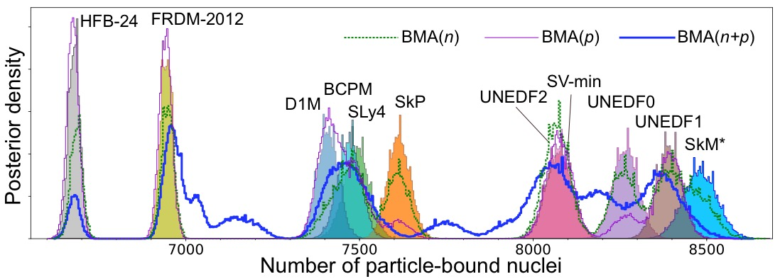
Limits of the nuclear landscape: Bayesian model averaging (BMA)
Rather than equal weights, average the models according to their predictive abilities: BMA
Uses 11 global nuclear mass models
Total: 7708 ± 534 nuclei
L. Neufcourt et al., Phys. Rev. C 101, 014319 (2020); arXiv:2001.05924
Probability for each nucleus (Z,N) to be bound shown as a color. Dripline at 50%.

Slide 29
Limits of the nuclear landscape II: Exploit ab-initio systematics
J. Holt, S. Stroberg, A. Schwenk, J. Simonis, arXiv:1905 (2019).
“Therefore our approach is to use measured data to assess how well separation energies are reproduced in general, then assume they will perform equally well for separation energies which have not yet been measured.”
Model checking:
Model for theoretical discrepancy: learn from observed statistics of residuals!

Slide 30
Correlated theory errors for infinite matter
Neutron star
What are the constraints on the infinite matter equation of state from microscopic calculations, accounting for correlations?
[Also see Drischler et al. (2017, 2019); Gandolfi et al. (2019), Lonardoni et al. (2019), …]

Slide 31
Correlated theory errors for infinite matter
C. Drischler, J. Melendez, rjf, D. Phillips (in prep.)
NN: Entem-Machleidt-Nosyk (450/500 MeV) with 3N LECs fitted to saturation
Order-by-order convergence
Error bands grow with density
⟹
Saturation: correlated ellipse! (Blue is N²LO and red is N³LO.)
Drischler et al., PRL (2019)

Slide 32
Correlated theory errors for infinite matter
Christian Drischler, Jordan Melendez, rjf, Daniel Phillips (in prep.)
NN potential: Entem-Machleidt-Nosyk (450/500 MeV) with 3N LECs fitted to saturation
Apply many-body perturbation theory at each order in χEFT.
Learn hyperparameters for GPs from coefficient functions.
Model checking tests how well the GP model works.
See Melendez et al., PRC (2019)
Find posteriors for breakdown scale
Model works best with separate treatment of 2N and 3N parts.
Notes:
Add a picture of the original source

Slide 33
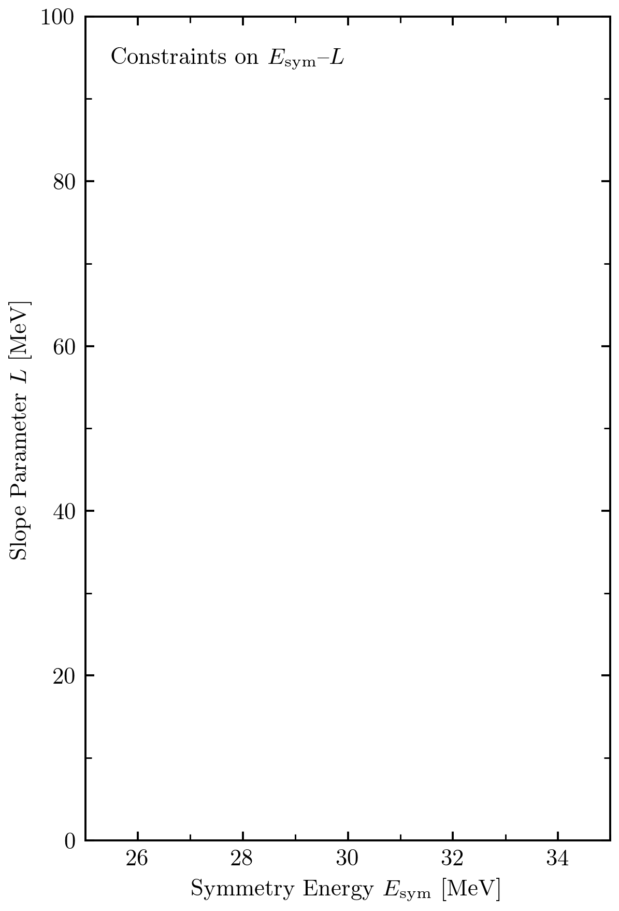
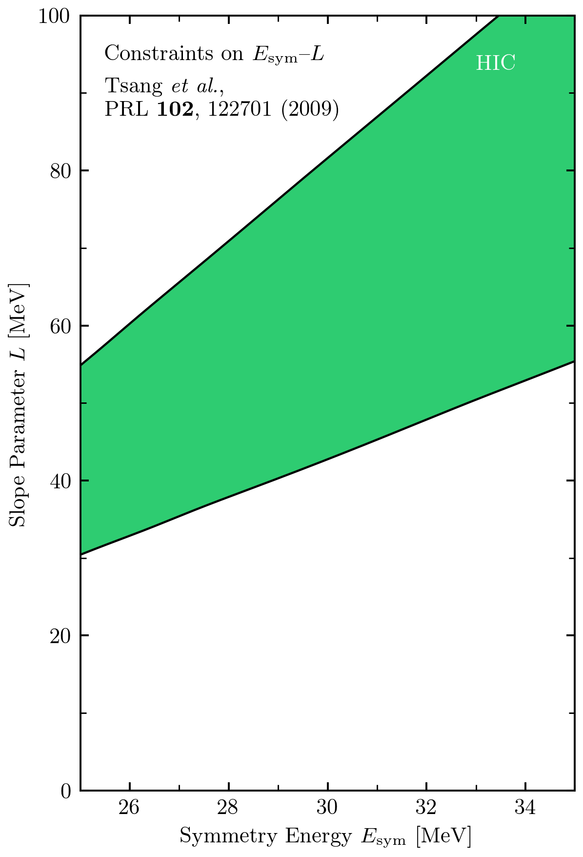
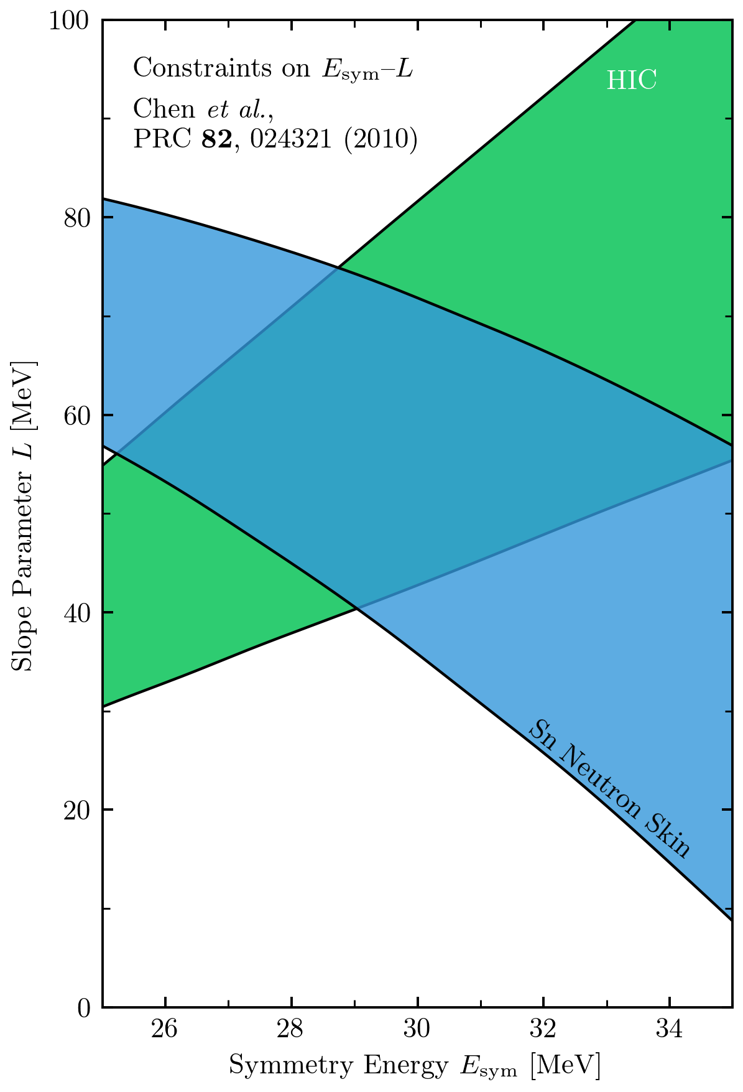
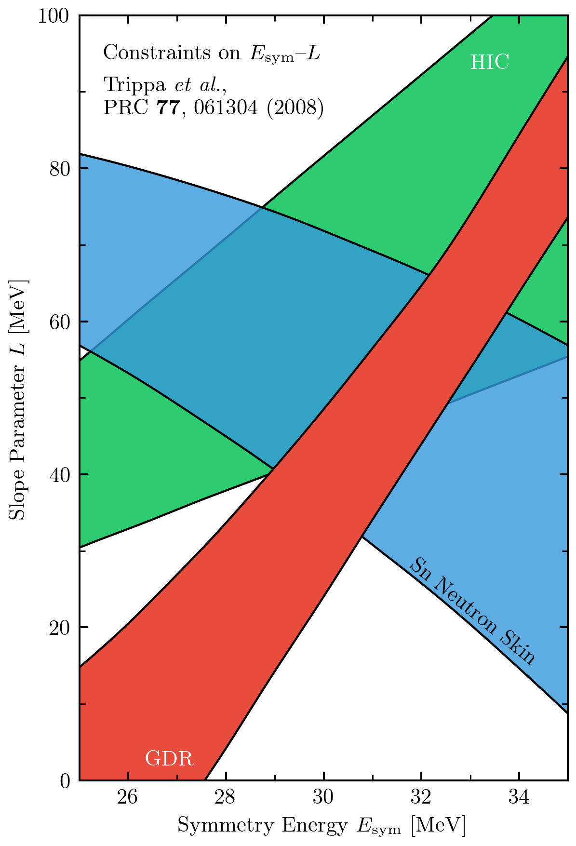
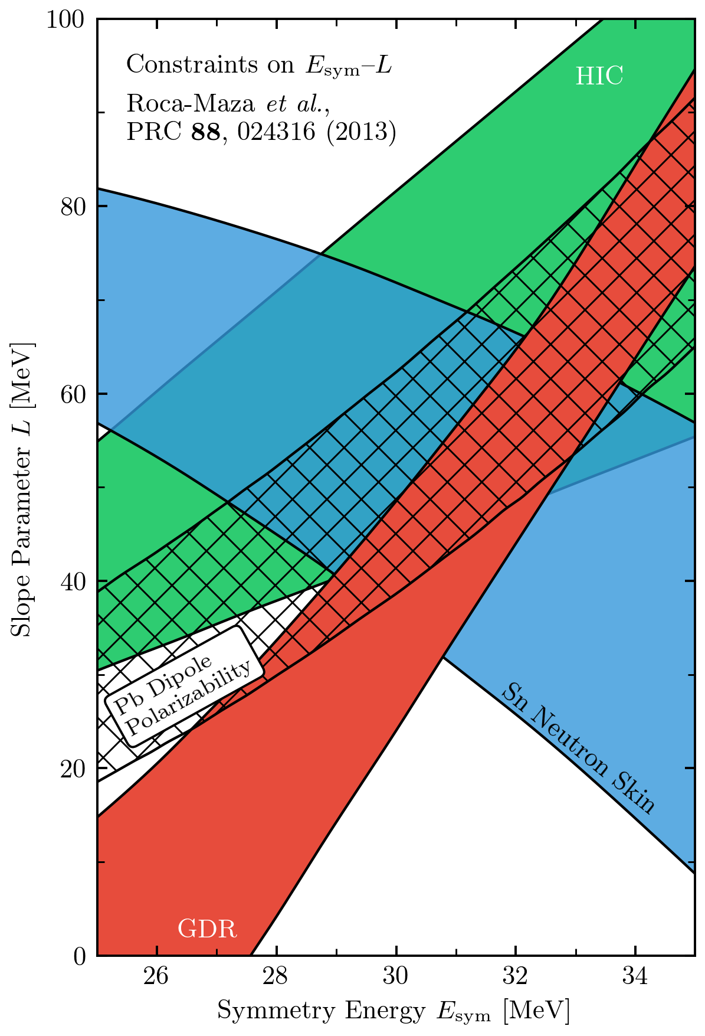
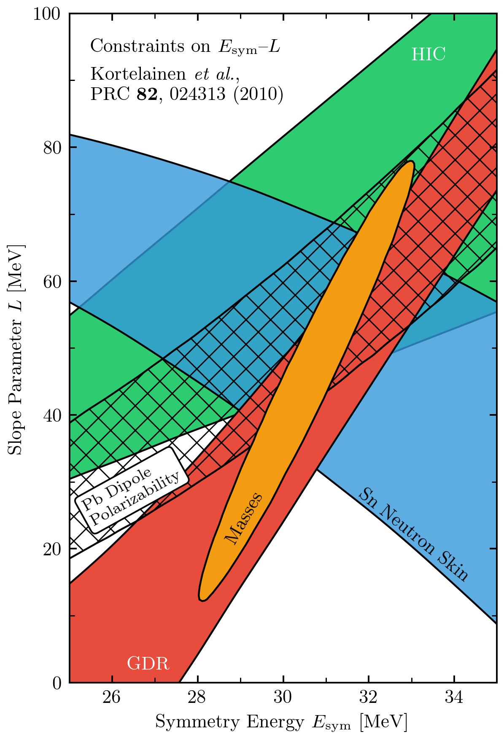
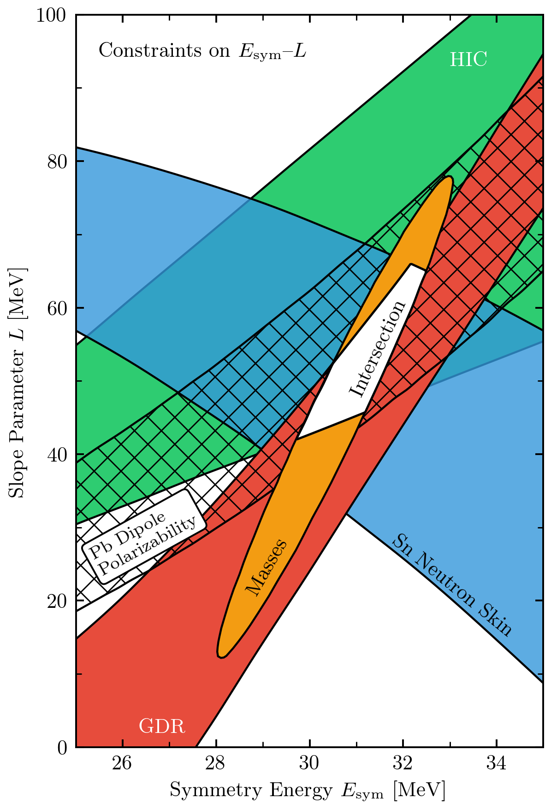
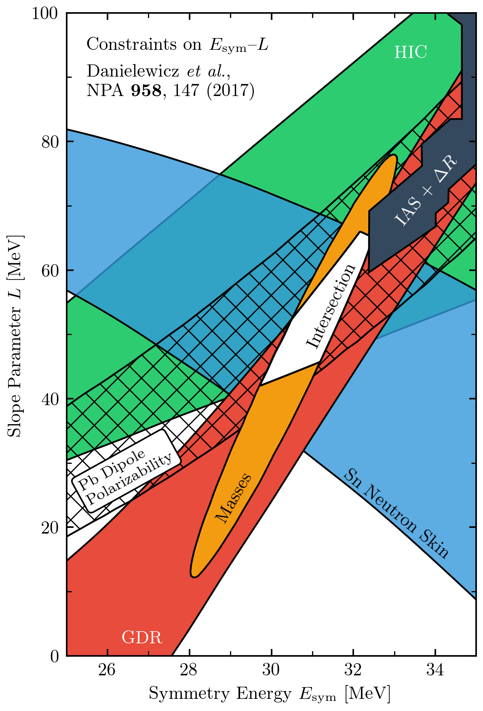
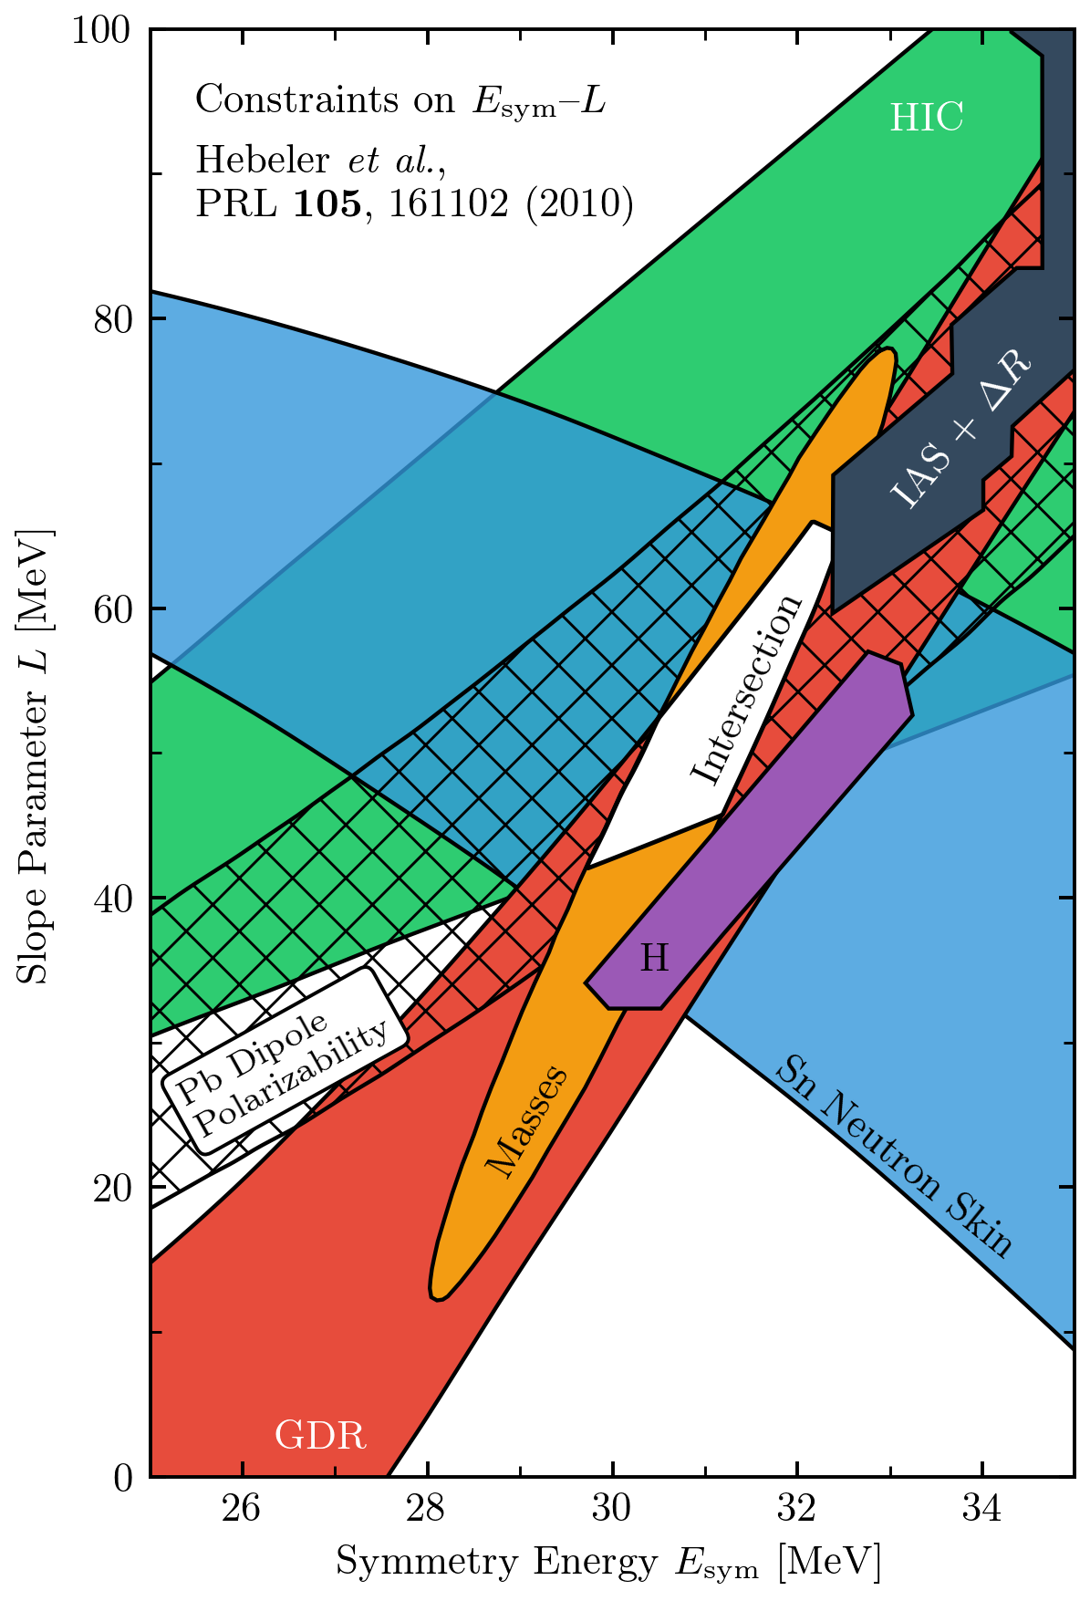
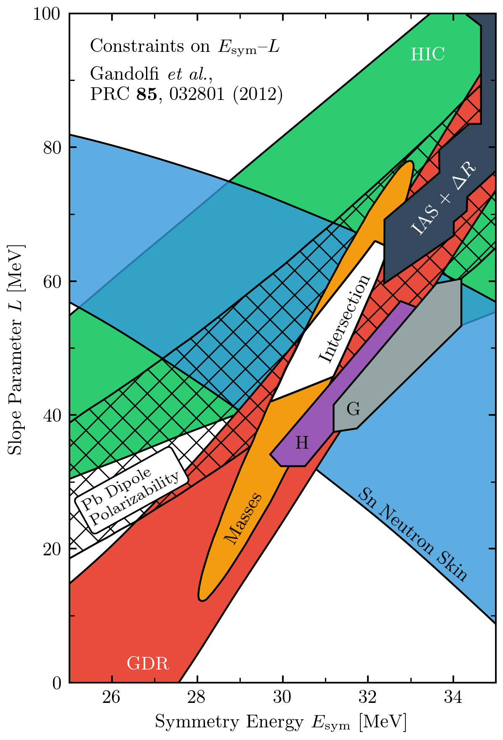
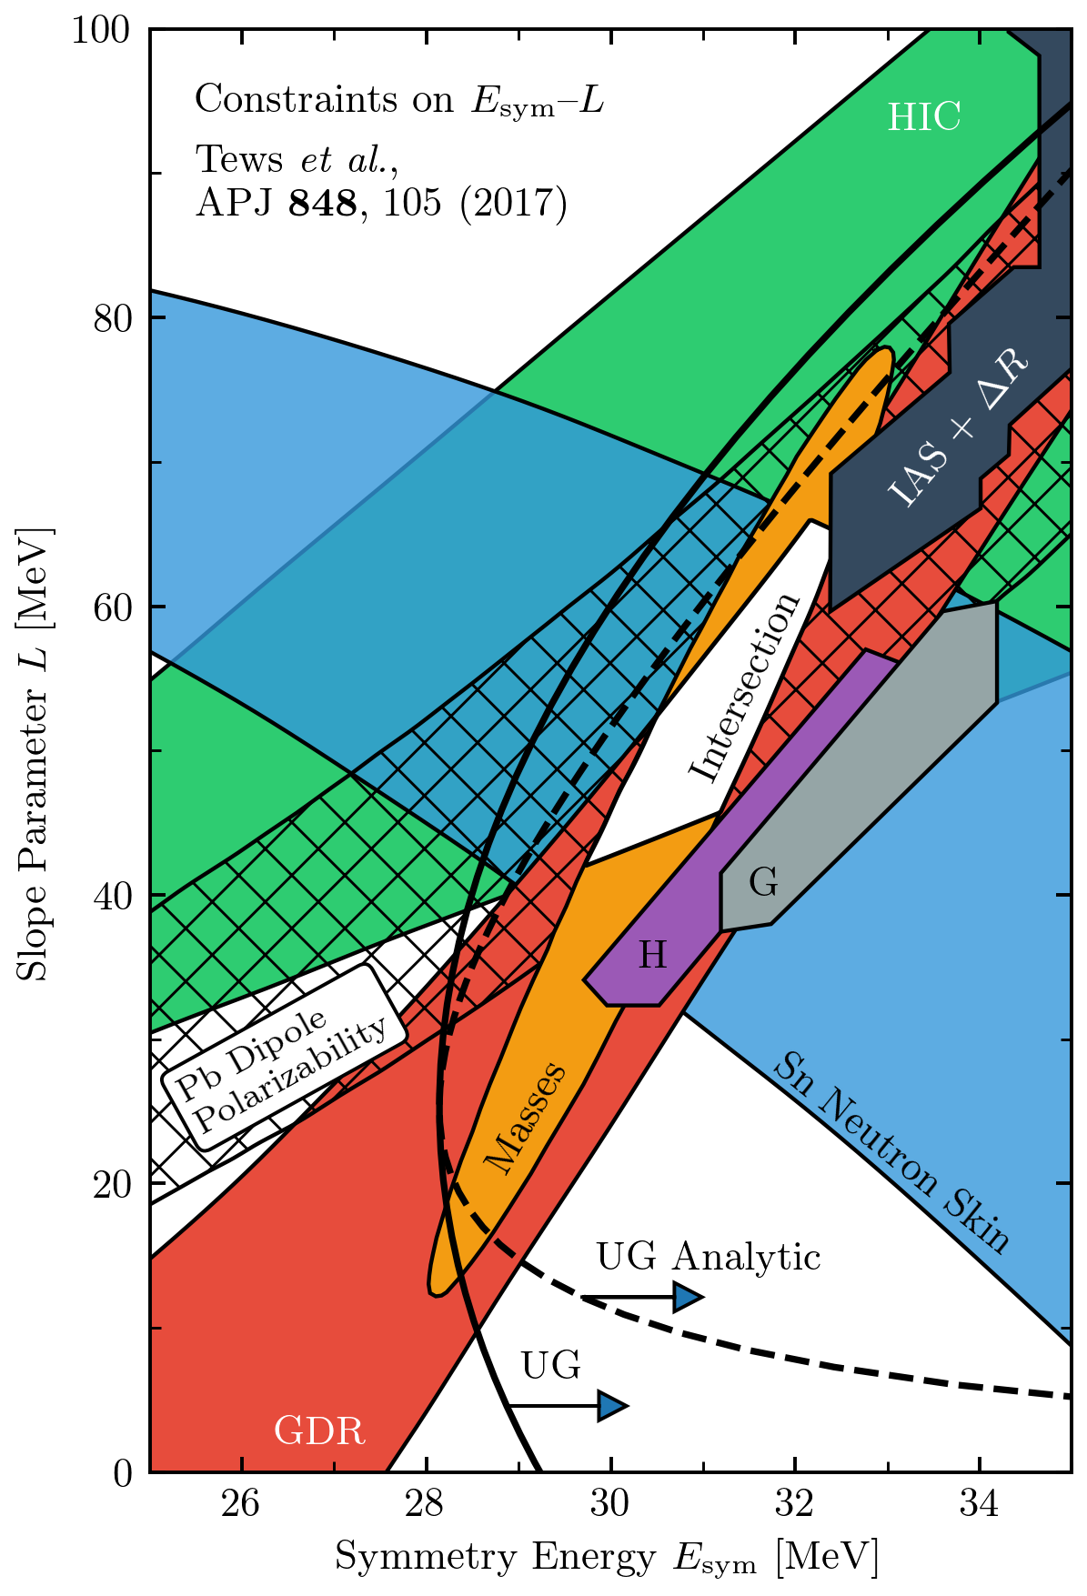

Correlated theory errors for EOS properties
C. Drischler et al. (in prep.)
at 0.17 ± 0.01 fm³
Correlated GP treatment gives better estimates for truncation errors and clean propagation of uncertainties to derived quantities.

Slide 34
Experimental design: A case study
Maximize benefits – minimize cost (time, money, workforce)
Nucleon polarizabilities from Compton scattering with ChiEFT
[Harald Griesshammer, Judith McGovern, Daniel Phillips, EPJA (2018)]
How do constituents of the nucleon react to external fields?
How to reliably extract proton, neutron, spin polarizabilities?
How to plan effective experiments and test theory?
Experiments: HI𝛾S; A2@MAMI → tension with ChiEFT valid range

Slide 35
Compton scattering via chiral effective field theory
See Comprehensive Study of Observables in Compton Scattering on the Nucleon, H. Griesshammer, J. McGovern, D. Phillips, arXiv:1711.11546 for chiEFT power counting.
Order-by-order coefficient functions in (ω, 𝜃) are natural sized ⇒ learn from convergence pattern

Slide 36
Optimizing the design of future Compton scattering experiments
How to plan effective experiments & test theory? What (ω, 𝜃) are most useful for constraining?
Given: (1) Present polarizability error bars; (2) χEFT accuracy decreases as ω↑; (3) experimental constraints.
J. Melendez et al. (in prep.)
Compare utility with and without truncation error included ⇒ very different implications!
Notes:
\documentclass[10pt]{article}
\usepackage[usenames]{color} %used for font color
\usepackage{amssymb} %maths
\usepackage{amsmath} %maths
\usepackage[utf8]{inputenc} %useful to type directly diacritic characters
\newcommand{\design}{{\color{blue}\mathbf{d}}}
\DeclareMathOperator*{\argmax}{arg\,max}
\newcommand{\shrinkage}{\mathcal{S}}
\newcommand{\omegalab}{\omega_{\text{lab}}}
\newcommand{\given}{\,|\,} % Use for | in \pr
%\DeclareMathOperator{\pr}{pr} % Good, but want to handle sizing and | spacing?
\DeclareMathOperator{\pr}{p} % Good, but want to handle sizing and | spacing?
% Now add spacing:
% Derivatives
\newcommand{\dd}{d}
\newcommand{\diffcs}{d\sigma} % differential cross section
\newcommand{\genobs}{y}
\newcommand{\genobsset}{{\color{green}\inputvec{\genobs}}}
\newcommand{\inputvec}{\mathbf}
\newcommand{\lecs}{{\color{red}\vec{a}}}
\mbox{Utility of {\color{blue}design}: }& \mbox{information gain averaged over {\color{red}parameters} and {\color{green}measurements}}
\\
U_{\text{KL}}(\design)
& = \int \!\!\left\{ \ln\!\!\left[\frac{\pr(\lecs \given \genobsset, \design)}{\pr(\lecs)}\right]\! \pr(\lecs \given \genobsset, \design) \dd{\lecs}\right\}\!
\pr(\genobsset \given \design) \dd{\genobsset} \quad\mbox{(cf.\ entropy)} \\
& \longrightarrow \frac{1}{2} \ln \frac{|V_0|}{|V(\design)|} \equiv \ln\shrinkage(\design) \quad\mbox{``Posterior shrinkage''}

Slide 37
Optimizing the design of future Compton scattering experiments
How to plan effective experiments & test theory? What (ω, 𝜃) are most useful for constraining?
Ingredient: Calculate a utility function for sum of variances for each kinematic point on a grid.
Apply to decide on trade-off between different allocations of experimental resources (exploration vs. exploitation).
1-point vs 5-point?
Increase precision or more points?
J. Melendez et al. (in prep.)

Slide 38
Outline
A brief history of theory error bars for nuclei
Basics of Bayesian statistics for uncertainty quantification (UQ), with examples
Ongoing applications of Bayesian methods to low-energy nuclear theory
Outlook: More frontiers in theory UQ

Slide 39
Bayes is great, but won’t the sampling be too expensive?
Dilemma: Bayesian sampling of posteriors is desirable, but modern nuclear theory calculations typically require supercomputer resources.
Solution: Emulators! Train a computer model of the calculation using a representative set of parameters and then sample from the model instead.
Gaussian process emulators: think about efficient interpolations formulas, but with error estimates. Eigenvector continuation: use a really effective variational basis (introduced for physics applications by Frame et al., PRL 121 (2018)).
Notes:
\documentclass[10pt]{article}
\usepackage[usenames]{color} %used for font color
\usepackage{amssymb} %maths
\usepackage{amsmath} %maths
\usepackage[utf8]{inputenc} %useful to type directly diacritic characters
\usepackage{bm}
\newcommand{\design}{{\color{blue}\mathbf{d}}}
\DeclareMathOperator*{\argmax}{arg\,max}
\newcommand{\shrinkage}{\mathcal{S}}
\newcommand{\omegalab}{\omega_{\text{lab}}}
\newcommand{\given}{\,|\,} % Use for | in \pr
%\DeclareMathOperator{\pr}{pr} % Good, but want to handle sizing and | spacing?
\DeclareMathOperator{\pr}{p} % Good, but want to handle sizing and | spacing?
% Now add spacing:
% Derivatives
\newcommand{\dd}{d}
\newcommand{\diffcs}{d\sigma} % differential cross section
\newcommand{\genobs}{y}
\newcommand{\genobsset}{{\color{green}\inputvec{\genobs}}}
\newcommand{\inputvec}{\mathbf}
\newcommand{\lecs}{{\color{red}\vec{a}}}
\newcommand{\alphavec}{\bm{\theta}}
&\mbox{Calculate $i = 1 \mbox{ to } N$ ground-state wfs: } \widehat H(\alphavec_i) |\psi_0(\alphavec_i) \rangle = E_0(\alphavec_i) |\psi_0(\alphavec_i) \rangle, \\
&\mbox{Use trial wavefunction from linear combination of $|\psi_0(\alphavec_i) \rangle$s: } \\
&{\color[rgb]{0.986246,0.007121,0.027434} \quad |\psi_{\text{trial}}\rangle = c_1 |\psi_0(\alphavec_1)\rangle + c_2 |\psi_0(\alphavec_2)\rangle + \cdots + c_N |\psi_0(\alphavec_N)\rangle} \\
&\mbox{Minimize $\langle \psi_{\text{trial}}| \widehat H(\alphavec) |\psi_{\text{trial}}\rangle$ with $\langle \psi_{\text{trial}}| \psi_{\text{trial}}\rangle = 1$ to find $E_0(\alphavec)$ and $c_i$s }

Slide 40
Bayes is great, but won’t the sampling be too expensive?
Eigenvector Continuation as an Efficient and Accurate Emulator
for Uncertainty Quantification
arXiv:1909.08446
S. König, A. Ekström, K. Hebeler, D. Lee, A. Schwenk
⁴He energy
⁴He energy

Slide 41
Bayes is great, but won’t the sampling be too expensive?
Global sensitivity analysis of bulk properties of an atomic nucleus
arXiv: 1910.02922
A. Ekström and G. Hagen
“We have to use (16 + 1) · 216 = 1,114,112 quasi MC samples to extract statistically significant main and total effects of the energy and radius for all LECs. With SP-CC(64) this took about 1 hour on a standard laptop, while an equivalent set of exact CCSD computations would require 20 years."

Slide 42
More frontiers in nuclear theory UQ
Parameter estimation including truncation errors: use EC!
E.g., three-body force determination (S. Wesolowski, Chalmers et al.)
Bayes for nuclear reactions: examples
Parameter estimation for direct reactions G.B. King et al. Phys. Rev. Lett. 122, 232502 (2019)
EFT + Bayes for ³He(α,γ)⁷Be using “supermodels” X. Zhang, K. Nollett, D. Phillips, arXiv:1909.07287
Interface with machine learning: make ML more Bayesian?
Bayesian model selection: opportunities and questions
E.g., competing EFT power countings P. Premarathna and Gautam Rupak; arXiv:1906.04143

Slide 43
Take-away points
Bayesian statistics is a powerful framework for nuclear theory uncertainty quantification (UQ).
Theory discrepancy model from residuals or, for EFTs, the convergence pattern and naturalness priors; GP truncation error model for correlations.
Model checking is an essential part of Bayesian UQ.
Need to sample for parameter estimation and the propagation of uncertainties: Eigenvector continuation is a very promising solution to computational load!
Parameter estimation with priors and truncation errors minimizes overfitting and dependence on how much data is used; posteriors used for diagnostics.
Model selection is a frontier for EFT Bayesian statistics.

Slide 44
Extra slides

Slide 45
TALENT: Training in Advanced Low-Energy Nuclear Theory
The TALENT initiative aims at providing advanced training to graduate students and young researchers in low-energy nuclear theory. TALENT offers intensive three-week courses on a rotating set of topics.
Bayes2019. Learning from Data: Bayesian Methods and Machine Learning,
at the University of York, UK, June 10-28, 2019. See the github site for many Jupyter notebooks and lecture notes: https://nucleartalent.github.io/Bayes2019/
TALENT courses scheduled for 2020 (see http://nucleartalent.org for more info):
Atomic Nuclei as Open Quantum Systems: Unifying Nuclear Structure and Reactions will be held at the INT in Seattle, WA from June 22 to July 10, 2020. Contact: Christian Forssén (christian.forssen@chalmers.se).
Density Functional Theory and Self-Consistent Methods will be held at LBNL, in Berkeley, CA. The dates are July 6 to July 24, 2020. Contact: Nicolas Schunck (schunck1@llnl.gov).
Machine Learning and Data Analysis for Nuclear Physics will be held at the ECT* in Trento, Italy. The dates are June 22 to July 10, 2020. Contact: Morten Hjorth-Jensen (hjensen@msu.edu).

Slide 46
Bayesian model selection: Two competing EFT power countings
Pradeepa Premarathna and Gautam Rupak; arXiv:1906.04143
Application to ³He(α, γ)⁷Be in Halo EFT

Slide 47
Effect of including truncation errors in parameter estimation
If effects of higher-order operators are absorbed by including theory errors, LEC extractions should be independent of E_{max}, the highest-energy datum used:
Uncorrelated assumption
Correlated assumption
Wesolowski et al., J. Phys. G (2019)

Slide 48
State of knowledge as probability distributions (pdfs)
pr(A, B | C) “joint probability (density) of A and B given C” (contingent on C)
A, B, C can be parameters, uncertainties, propositions, models, …
cf. quantum mechanics |ψ(x, y)|² or |ψ(x)|² = ∫ |ψ(x, y)|² dy (marginalization)
Bayesian confidence (credible) integral:
xkcd.com/2110
pr(μ, σ² | I) = pr(μ |σ², I) x pr(σ² | I) ⇒
pdf of hyperparameters given information I (``product rule’’)
Examples of pdfs for theory UQ:

Slide 49
BUQEYE Collaboration (“Bayesian Uncertainty Quantification: Errors for Your EFT”)
https://buqeye.github.io
gsum: A Bayesian model of series convergence using Gaussian sums.
The gsum package provides convenient classes that allow one to analyze the convergence pattern of Effective Field Theory (EFT) observables. Specifically, this is a conjugacy-based implementation of the statistical model described in arXiv:1904.10581.
Correlated truncation errors in effective field theory: The code behind the manuscript. This Jupyter notebook provides the Python code to reproduce all of the plots from Melendez et al., Phys. Rev. C 100, 044001 (2019), arXiv:1904.10581.

